Slide 1
Data Mining for Business Intelligence
Chapter 9: Classification and Regression Trees
Kichun Lee, Ph.D.
Department of Industrial Engineering
Hanyang University, Seoul, Korea

Slide 2
Trees and Rules
Goal: Classify or predict an outcome based on a set of predictors
The output is a set of rules
Example:
Goal: classify a record as “will accept credit card offer” or “will not accept”
Rule might be “IF (Income > 92.5) AND (Education < 1.5) AND (Family <= 2.5) THEN Class = 0 (nonacceptor)
Also called CART, Decision Trees, or just Trees
Rules are represented by tree diagrams

Slide 3
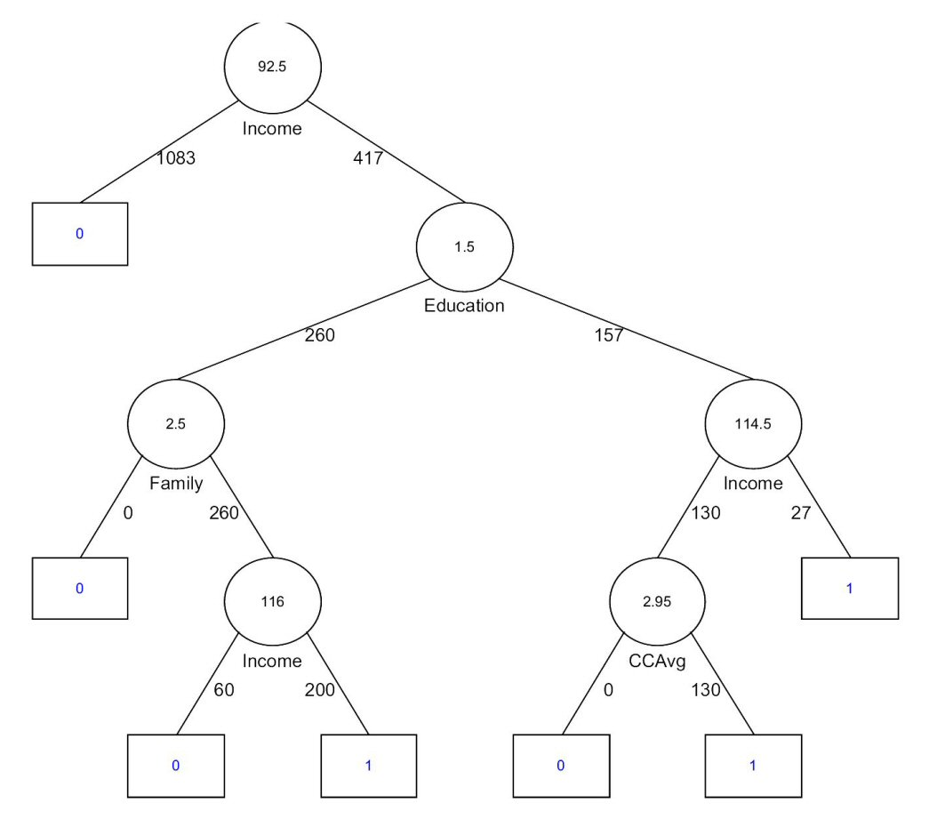

Slide 4
Key Ideas
Recursive partitioning: Repeatedly split the records into two parts so as to achieve maximum homogeneity within the new parts
Pruning the tree: Simplify the tree by pruning peripheral branches to avoid overfitting

Slide 5
Recursive Partitioning

Slide 6
Recursive Partitioning Steps
Pick one of the predictor variables, x_{i}
Pick a value of x_{i,} say s_{i}, that divides the training data into two (not necessarily equal) portions
Measure how “pure” or homogeneous each of the resulting portions are
“Pure” = containing records of mostly one class
Algorithm tries different values of x_{i,} and s_{i} to maximize purity in initial split
After you get a “maximum purity” split, repeat the process for a second split, and so on

Slide 7
Example: Riding Mowers
Goal: Classify 24 households as owning or not owning riding mowers
Predictors = Income, Lot Size

Slide 9
How to split
Order records according to one variable, say lot size
Find midpoints between successive values
E.g. first midpoint is 14.4 (halfway between 14.0 and 14.8)
Divide records into those with lotsize > 14.4 and those < 14.4
After evaluating that split, try the next one, which is 15.4 (halfway between 14.8 and 16.0)

Slide 10
Note: Categorical Variables
Examine all possible ways in which the categories can be split.
E.g., categories A, B, C can be split 3 ways
{A} and {B, C}
{B} and {A, C}
{C} and {A, B}
With many categories, # of splits becomes huge
XLMiner supports only binary categorical variables

Slide 11
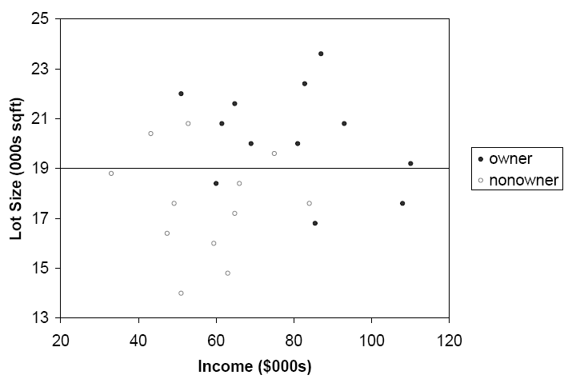
The first split: Lot Size = 19,000

Slide 12
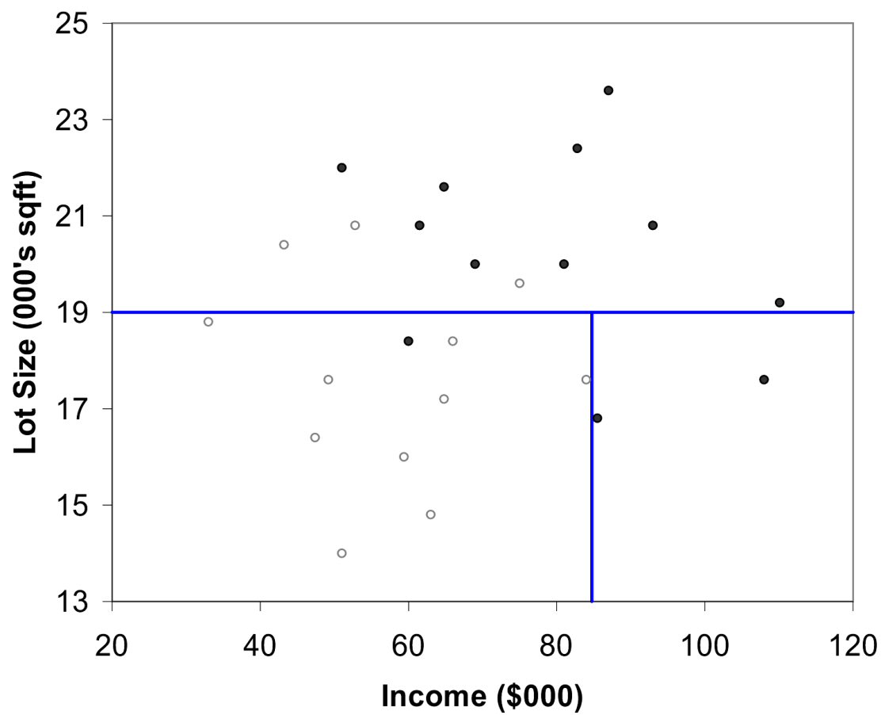
Second Split: Income = $84,000

Slide 13
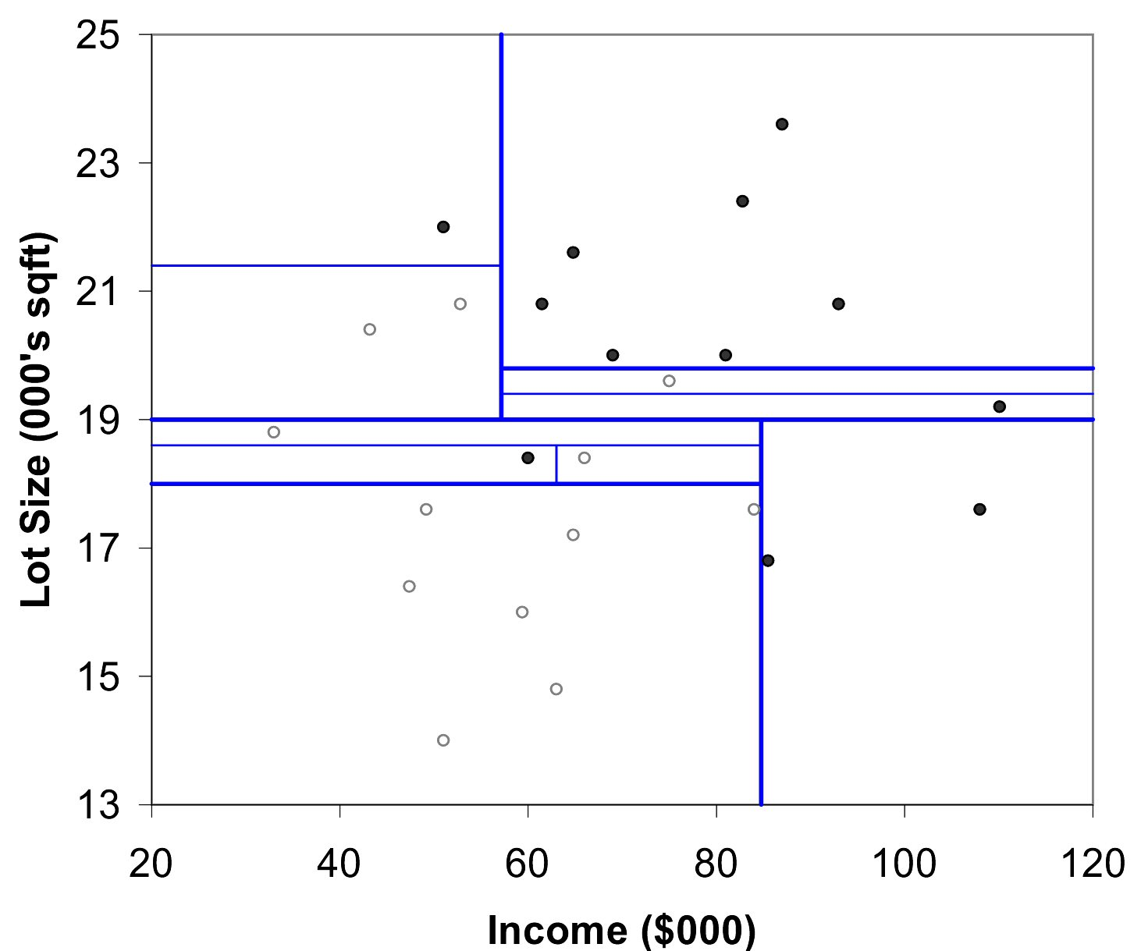
After All Splits

Slide 14
Measuring Impurity

Slide 15
Gini Index
Gini Index for rectangle A containing m records
p = proportion of cases in rectangle A that belong to class k
I(A) = 0 when all cases belong to same class
Max value when all classes are equally represented (= 0.50 in binary case)
Note: XLMiner uses a variant called “delta splitting rule”

Slide 16
Entropy
p = proportion of cases (out of m) in rectangle A that belong to class k
Entropy ranges between 0 (most pure) and log₂(m) (equal representation of classes)

Slide 17
Impurity and Recursive Partitioning
Obtain overall impurity measure (weighted avg. of individual rectangles)
At each successive stage, compare this measure across all possible splits in all variables
Choose the split that reduces impurity the most
Chosen split points become nodes on the tree

Slide 18
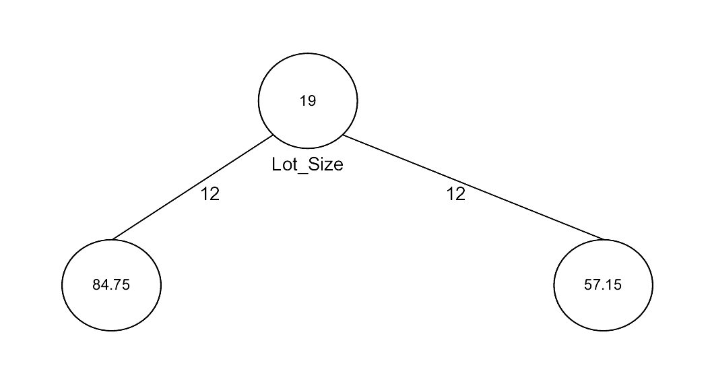
First Split – The Tree

Slide 19
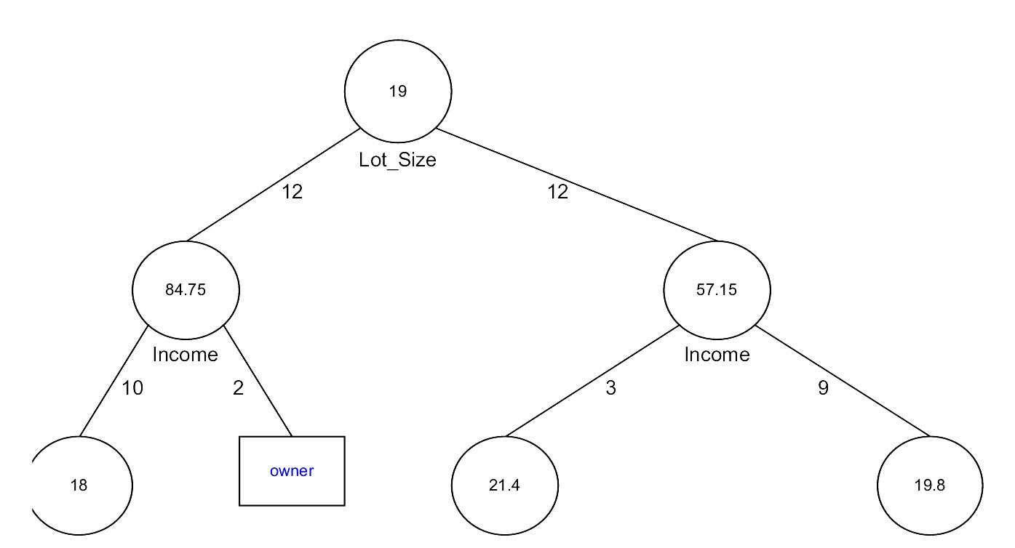
Tree after three splits

Slide 20
Tree Structure
Split points become nodes on tree (circles with split value in center)
Rectangles represent “leaves” (terminal points, no further splits, classification value noted)
Numbers on lines between nodes indicate # cases
Read down tree to derive rule
E.g., If lot size < 19, and if income > 84.75, then class = “owner”

Slide 21
Determining Leaf Node Label
Each leaf node label is determined by “voting” of the records within it, and by the cutoff value
Records within each leaf node are from the training data
Default cutoff=0.5 means that the leaf node’s label is the majority class.
Cutoff = 0.75: requires majority of 75% or more “1” records in the leaf to label it a “1” node

Slide 22
Decision Tree Learning
Day
Outlook
Temperature
Humidity
Wind
PlayTennis
D1
Sunny
Hot
High
Weak
No
D2
Sunny
Hot
High
Strong
No
D3
Overcast
Hot
High
Weak
Yes
D4
Rain
Mild
High
Weak
Yes
D5
Rain
Cool
Normal
Weak
Yes
D6
Rain
Cool
Normal
Strong
No
D7
Overcast
Cool
Normal
Strong
Yes
D8
Sunny
Mild
High
Weak
No
D9
Sunny
Cool
Normal
Weak
Yes
D10
Rain
Mild
Normal
Weak
Yes
D11
Sunny
Mild
Normal
Strong
Yes
D12
Overcast
Mild
High
Strong
Yes
D13
Overcast
Hot
Normal
Weak
Yes
D14
Rain
Mild
High
Strong
No
[See: Tom M. Mitchell, Machine Learning, McGraw-Hill, 1997]

Slide 23
Decision Tree Learning
Building a Decision Tree
First test all attributes and select the on that would function as the best root;
Break-up the training set into subsets based on the branches of the root node;
Test the remaining attributes to see which ones fit best underneath the branches of the root node;
Continue this process for all other branches until
all examples of a subset are of one type
there are no examples left (return majority classification of the parent)
there are no more attributes left (default value should be majority classification)

Slide 24
Decision Tree Learning
Determining which attribute is best (Entropy & Gain)
Entropy (E) is the minimum number of bits needed in order to classify an arbitrary example as yes or no
E(S) = Σ^{c}_{i=1} –p_{i} log₂ p_{i ,}
Where S is a set of training examples,
c is the number of classes, and
p_{i} is the proportion of the training set that is of class i
For our entropy equation 0 log₂ 0 = 0
The information gain G(S,A) where A is an attribute
G(S,A) ≡ E(S) - Σ_{v in Values(A)} (|S_{v}| / |S|) * E(Sv)

Slide 25
Decision Tree Learning
Let’s Try an Example!
Let
E([X+,Y-]) represent that there are X positive training elements and Y negative elements.
Therefore the Entropy for the training data, E(S), can be represented as E([9+,5-]) because of the 14 training examples 9 of them are yes and 5 of them are no.

Slide 26
Decision Tree Learning: A Simple Example
Let’s start off by calculating the Entropy of the Training Set.
E(S) = E([9+,5-]) = (-9/14 log₂ 9/14) + (-5/14 log₂ 5/14)
= 0.94

Slide 27
Decision Tree Learning: A Simple Example
Next we will need to calculate the information gain G(S,A) for each attribute A where A is taken from the set {Outlook, Temperature, Humidity, Wind}.

Slide 28
Decision Tree Learning: A Simple Example
The information gain for Outlook is:
G(S,Outlook) = E(S) – [5/14 * E(Outlook=sunny) + 4/14 * E(Outlook = overcast) + 5/14 * E(Outlook=rain)]
G(S,Outlook) = E([9+,5-]) – [5/14*E(2+,3-) + 4/14*E([4+,0-]) + 5/14*E([3+,2-])]
G(S,Outlook) = 0.94 – [5/14*0.971 + 4/14*0.0 + 5/14*0.971]
G(S,Outlook) = 0.246

Slide 29
Decision Tree Learning: A Simple Example
G(S,Temperature) = 0.94 – [4/14*E(Temperature=hot) + 6/14*E(Temperature=mild) + 4/14*E(Temperature=cool)]
G(S,Temperature) = 0.94 – [4/14*E([2+,2-]) + 6/14*E([4+,2-]) + 4/14*E([3+,1-])]
G(S,Temperature) = 0.94 – [4/14 + 6/14*0.918 + 4/14*0.811]
G(S,Temperature) = 0.029

Slide 30
Decision Tree Learning: A Simple Example
G(S,Humidity) = 0.94 – [7/14*E(Humidity=high) + 7/14*E(Humidity=normal)]
G(S,Humidity = 0.94 – [7/14*E([3+,4-]) + 7/14*E([6+,1-])]
G(S,Humidity = 0.94 – [7/14*0.985 + 7/14*0.592]
G(S,Humidity) = 0.1515

Slide 31
Decision Tree Learning: A Simple Example
G(S,Wind) = 0.94 – [8/14*0.811 + 6/14*1.00]
G(S,Wind) = 0.048

Slide 32
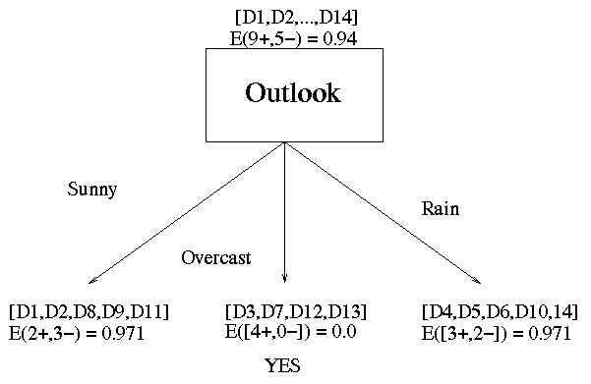
Decision Tree Learning: A Simple Example
Outlook is our winner!

Slide 33
Decision Tree Learning: A Simple Example
Now that we have discovered the root of our decision tree we must now recursively find the nodes that should go below Sunny, Overcast, and Rain.

Slide 34
Decision Tree Learning: A Simple Example
G(Outlook=Rain, Humidity) = 0.971 – [2/5*E(Outlook=Rain ^ Humidity=high) + 3/5*E(Outlook=Rain ^Humidity=normal]
G(Outlook=Rain, Humidity) = 0.02
G(Outlook=Rain,Wind) = 0.971- [3/5*0 + 2/5*0]
G(Outlook=Rain,Wind) = 0.971

Slide 35
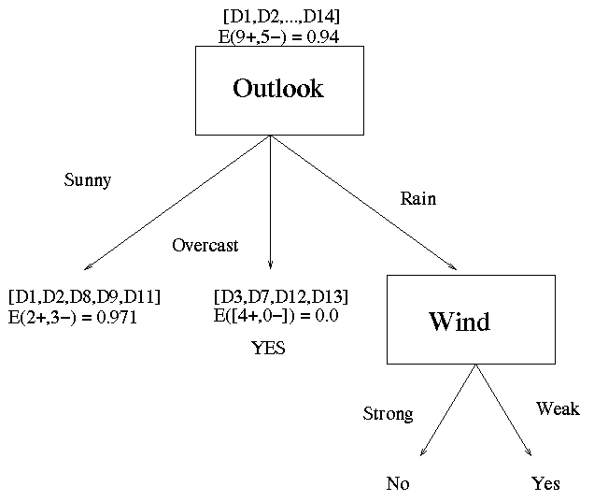
Decision Tree Learning: A Simple Example
Now our decision tree looks like:

Slide 36
The Overfitting Problem

Slide 37
Stopping Tree Growth
Natural end of process is 100% purity in each leaf
This overfits the data, which end up fitting noise in the data
Overfitting leads to low predictive accuracy of new data
Past a certain point, the error rate for the validation data starts to increase

Slide 38
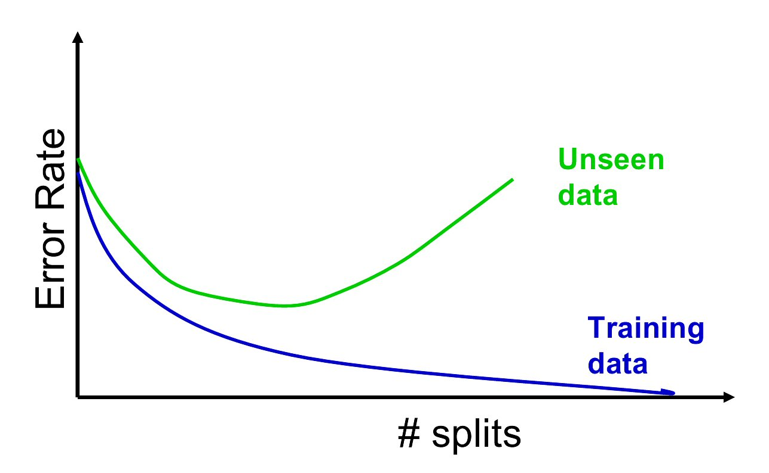
Full Tree Error Rate

Slide 39
Pruning
CART lets tree grow to full extent, then prunes it back
Idea is to find that point at which the validation error begins to rise
Generate successively smaller trees by pruning leaves
At each pruning stage, multiple trees are possible
Use cost complexity to choose the best tree at that stage

Slide 40
Cost Complexity
CC(T) = Err(T) + α L(T)
CC(T) = cost complexity of a tree
Err(T) = proportion of misclassified records
α = penalty factor attached to tree size (set by user)
Among trees of given size, choose the one with lowest CC
Do this for each size of tree

Slide 41
Using Validation Error to Prune
Pruning process yields a set of trees of different sizes and associated error rates
Two trees of interest:
Minimum error tree
Has lowest error rate on validation data
Best pruned tree
Smallest tree within one std. error of min. error
This adds a bonus for simplicity/parsimony

Slide 42
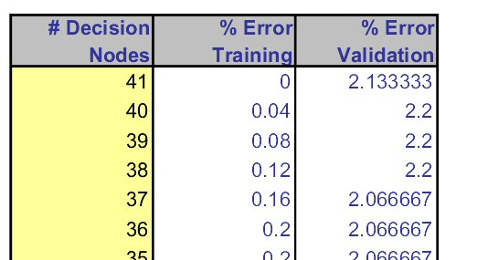
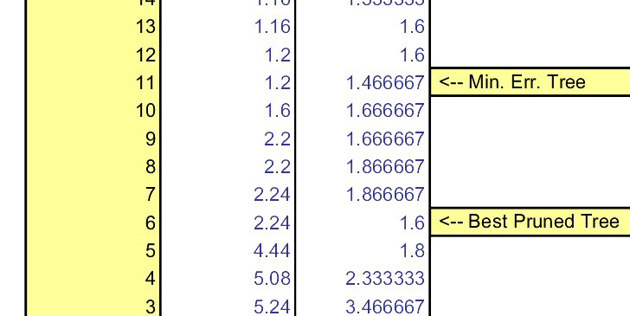
Error rates on pruned trees

Slide 43
Regression Trees

Slide 44
Regression Trees for Prediction
Used with continuous outcome variable
Procedure similar to classification tree
Many splits attempted, choose the one that minimizes impurity

Slide 45
Differences from CT
Prediction is computed as the average of numerical target variable in the rectangle (in CT it is majority vote)
Impurity measured by sum of squared deviations from leaf mean
Performance measured by RMSE (root mean squared error)

Slide 46
Advantages of trees
Easy to use, understand
Produce rules that are easy to interpret & implement
Variable selection & reduction is automatic
Do not require the assumptions of statistical models
Can work without extensive handling of missing data

Slide 47
Disadvantages
May not perform well where there is structure in the data that is not well captured by horizontal or vertical splits
Since the process deals with one variable at a time, no way to capture interactions between variables

Slide 48
Summary
Classification and Regression Trees are an easily understandable and transparent method for predicting or classifying new records
A tree is a graphical representation of a set of rules
Trees must be pruned to avoid over-fitting of the training data
As trees do not make any assumptions about the data structure, they usually require large samples

